Slide 1
GLENDALE
COMMUNITY COLLEGE
Project ASCEND
Spring 2016

Slide 2
Team Members
Ashley Campbell
Reagan DeVoe
Bianca Pina
Bailey Leavitt
Phillip Noel
Shayne Caraway
Noah Habib
Hito Cerron
Advisor: William Stein

Slide 3
Team Objectives
Learn how to become a useful member of a technical team.
Learn how to communicate effectively.
Learn how to work collaboratively.
Learn how to work in a proper organizational structure.
Come up with a scientific experiment that satisfies payload constraints.
Engineer, design, build/assemble, necessary parts of the project puzzle

Slide 4
The Experiment
Study the Effects of Combined Extreme Physical Conditions of Near-Space on Bacteria.
These conditions include low temperature, low pressure, high ultraviolet radiation, and high ionizing radiation.

Slide 5
Abstract
GCC ASCEND: Effects of Combined Extreme Physical Conditions on Bacteria
A high-altitude (lower stratosphere) balloon flight offers a unique combination of extreme physical conditions not reproducible in combination at Glendale Community College. These conditions include low temperature, low pressure, high ultraviolet radiation, and high ionizing radiation. Working with the GCC Biotechnology department, the intent is to study effects of the combined extreme conditions of near-space on bacteria. This experiment requires designing and constructing a capsule that safely contains bacterial samples in a manner that also exposes the samples to the environment of near-space. Recording measurements of physical conditions vs. time is required, and many sensors wired to micro-controllers are used for data acquisition. A control group of bacterial samples are kept on earth for comparison to experimental samples that fly in the capsule. All aspects of this experiment are executed by GCC undergraduate students, including the design of experiment, engineering, selection of materials and hardware, programming, construction, and laboratory research.

Slide 6
Sub-Teams
The main Sub-teams we organized our 8 team members into:
Capsule…partial success
Programming…partial success regarding learning, but failure in flight.
Geiger…partial success regarding learning, but failure for flight (because we used an off-the-shelf, self-logging product for the flight).
Camera…partial success regarding learning, but failure for flight.
Biology…full success regarding integrity of petri-dishes during & after flight. But regarding the actual experiment, we don’t know yet

Slide 7
Capsule
Design
Was (eventually) a cost effective solution, in both dollars and time
Didn’t engineer the container (thanks Walmart for $4 plastic container)
Attached circuit boards, and bacterial sample platforms to the rod
Partial Success
It did protect the contents of the capsule (bacteria, electronics, etc.)
It all came back, all in one piece; There was no apparent damage.

Slide 8
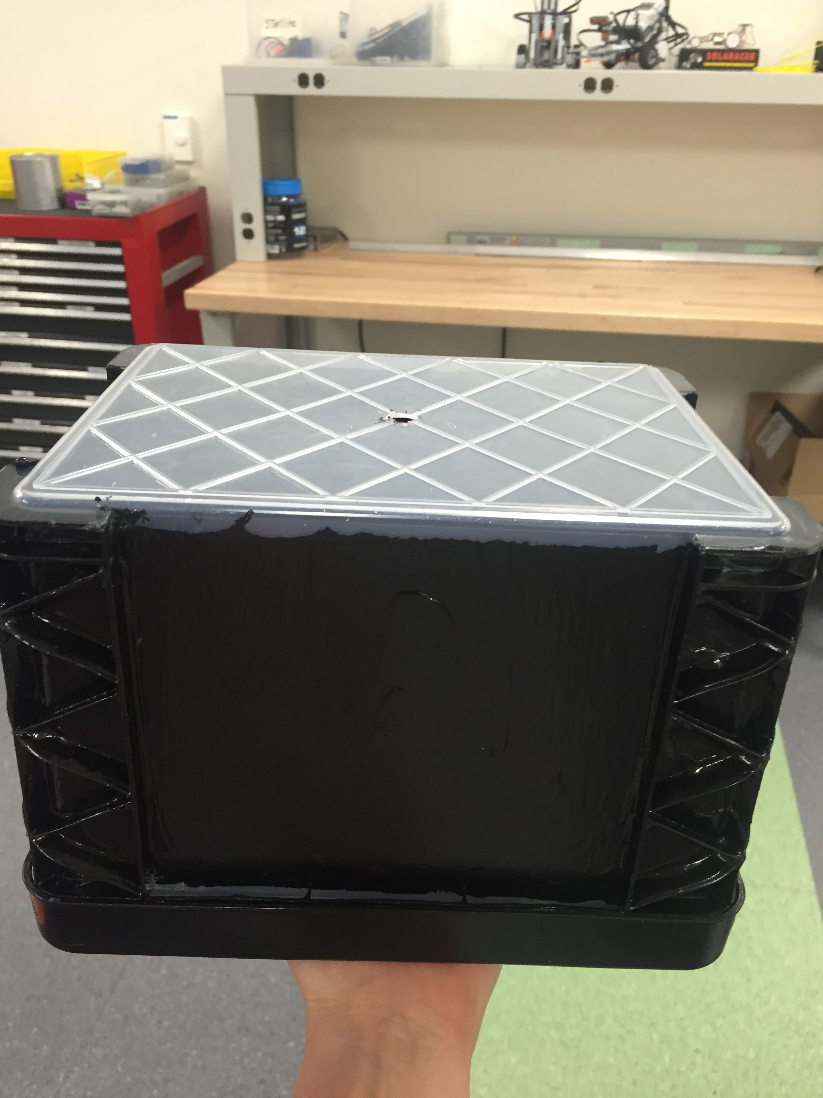
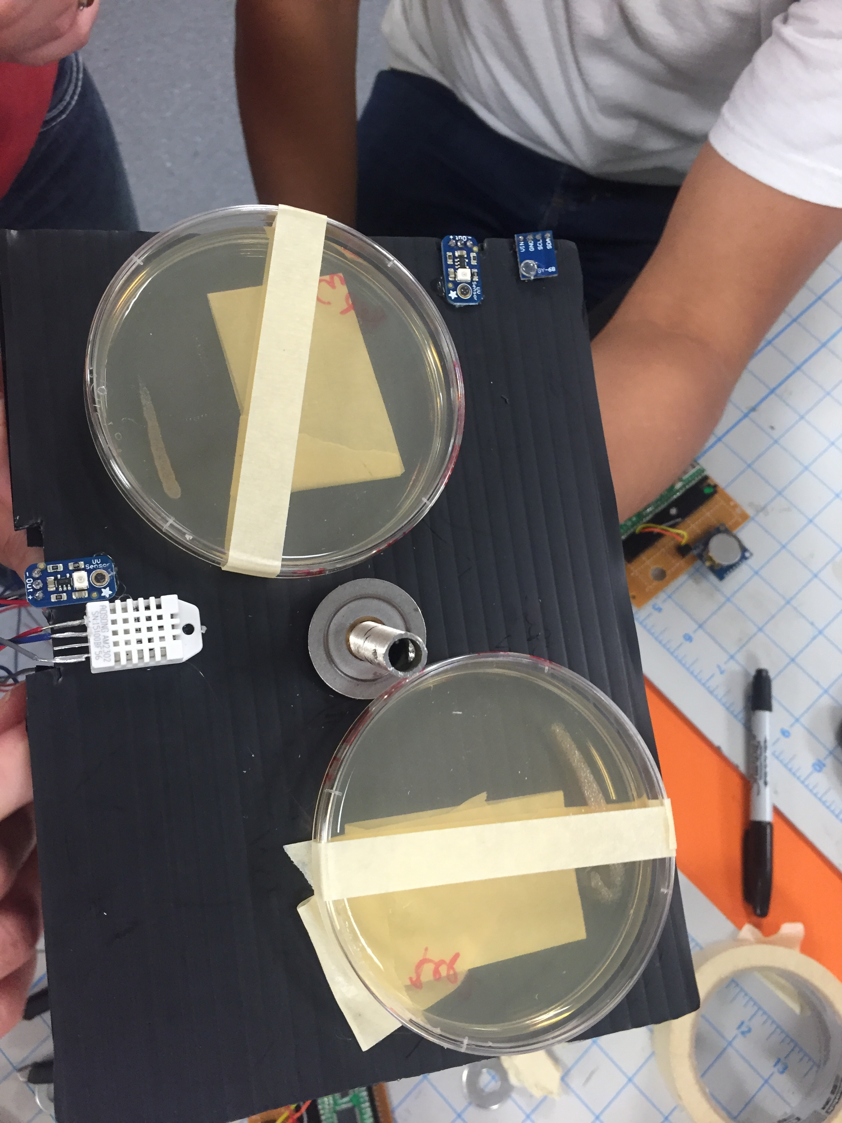
Capsule Design
Capsule we finally settled on was a cost effective solution, in both dollars and time.
We didn’t engineer the container (thanks Walmart for $4 plastic container). Previous efforts to engineer our own took too long and wasted a lot of time.
Attached circuit boards, and experiment platforms to the rod.
Painted exterior black EXCEPT top (to allow UV light in).

Slide 9
Capsule: Partial Success
It did protect the contents of the capsule (bacteria, electronics, etc.)
It all came back, all in one piece.
There was no apparent damage.

Slide 10
Geiger Counter
  Objective:
  To build our own Geiger counter that would be smaller than consumer products and capable of interfacing with our micro-controller
  Outcome:
  We did not successfully build a Geiger counter. Instead, a standalone Geiger counter that logged data was included in the capsule.

Slide 11
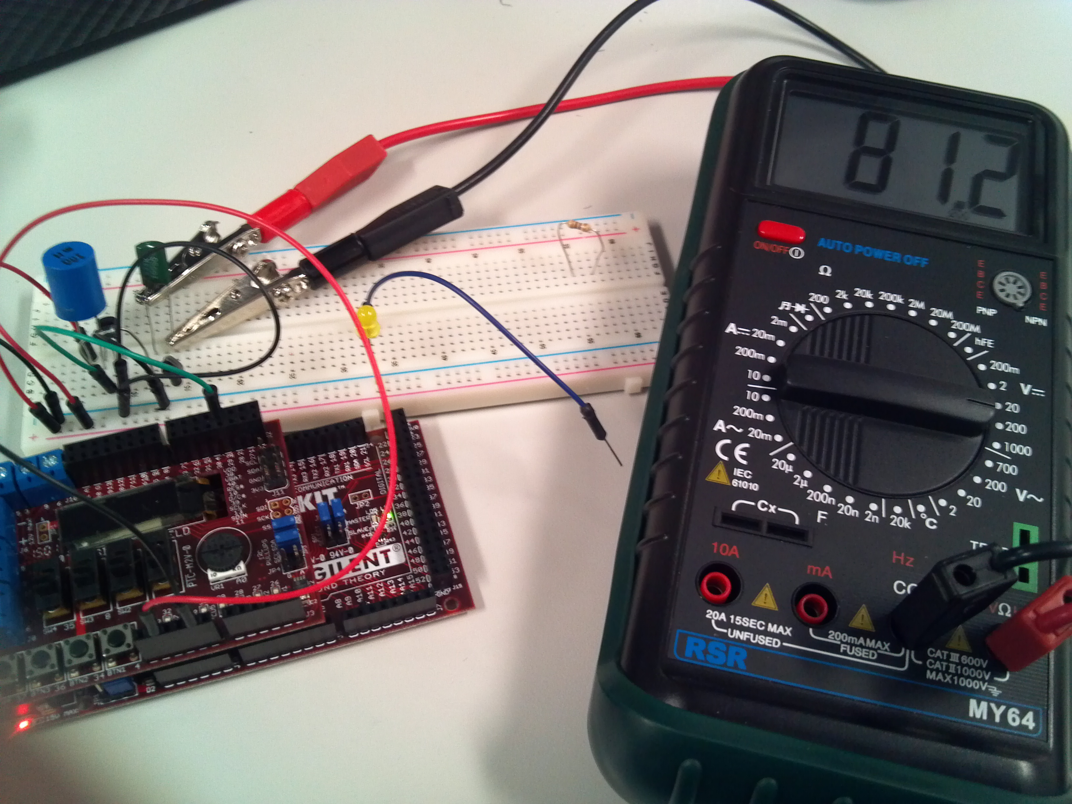
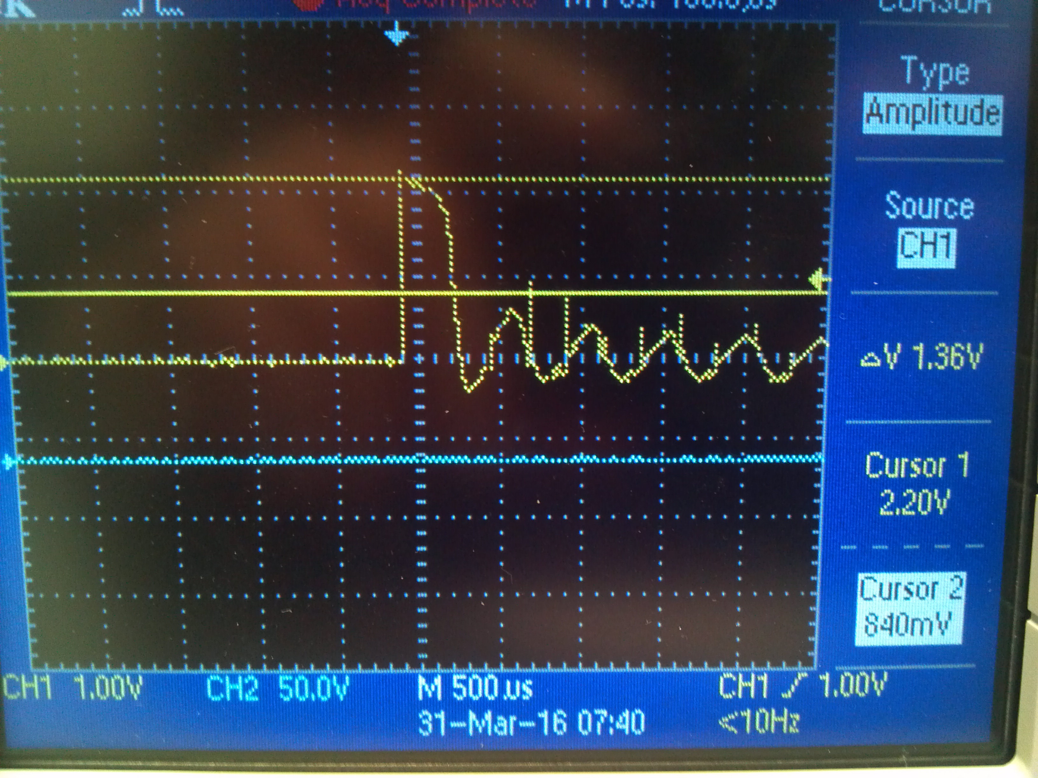
To detect beta and gamma radiation the Geiger tube we used (GQ m4011) requires an input voltage of 380-450v.
We boosted 3.3v to 92v but did not test the voltage booster with a higher input voltage.
Plan B was to interface an off-the-shelf Geiger counter with the payload’s motherboard.
The Geiger counter we intended to use, the GQ GMC200, does not log data. To interface with the motherboard we intended to trigger an interrupt using the signal from an LED on the Geiger counter.

Slide 12
Geiger Counter
Successes:
  Learned about Geiger Counters
  Voltage boosters from 3.3 V to 92 V (but the goal was 500-600 V)
Failures:
  Wasted around $400 the past two semesters on Geiger “solutions.”
  Communication

Slide 13
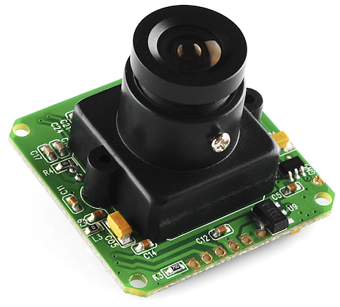
Camera
“No, we didn’t use a GoPro.”
Successes:
  Clear images saved to the SD card
  Learned about hexadecimal data, the JPG, serial communication
Failures:
  Was not integrated into the main program
UART vs. SPI vs. I2C
LSY201 JPEG Camera UART Interface

Slide 14
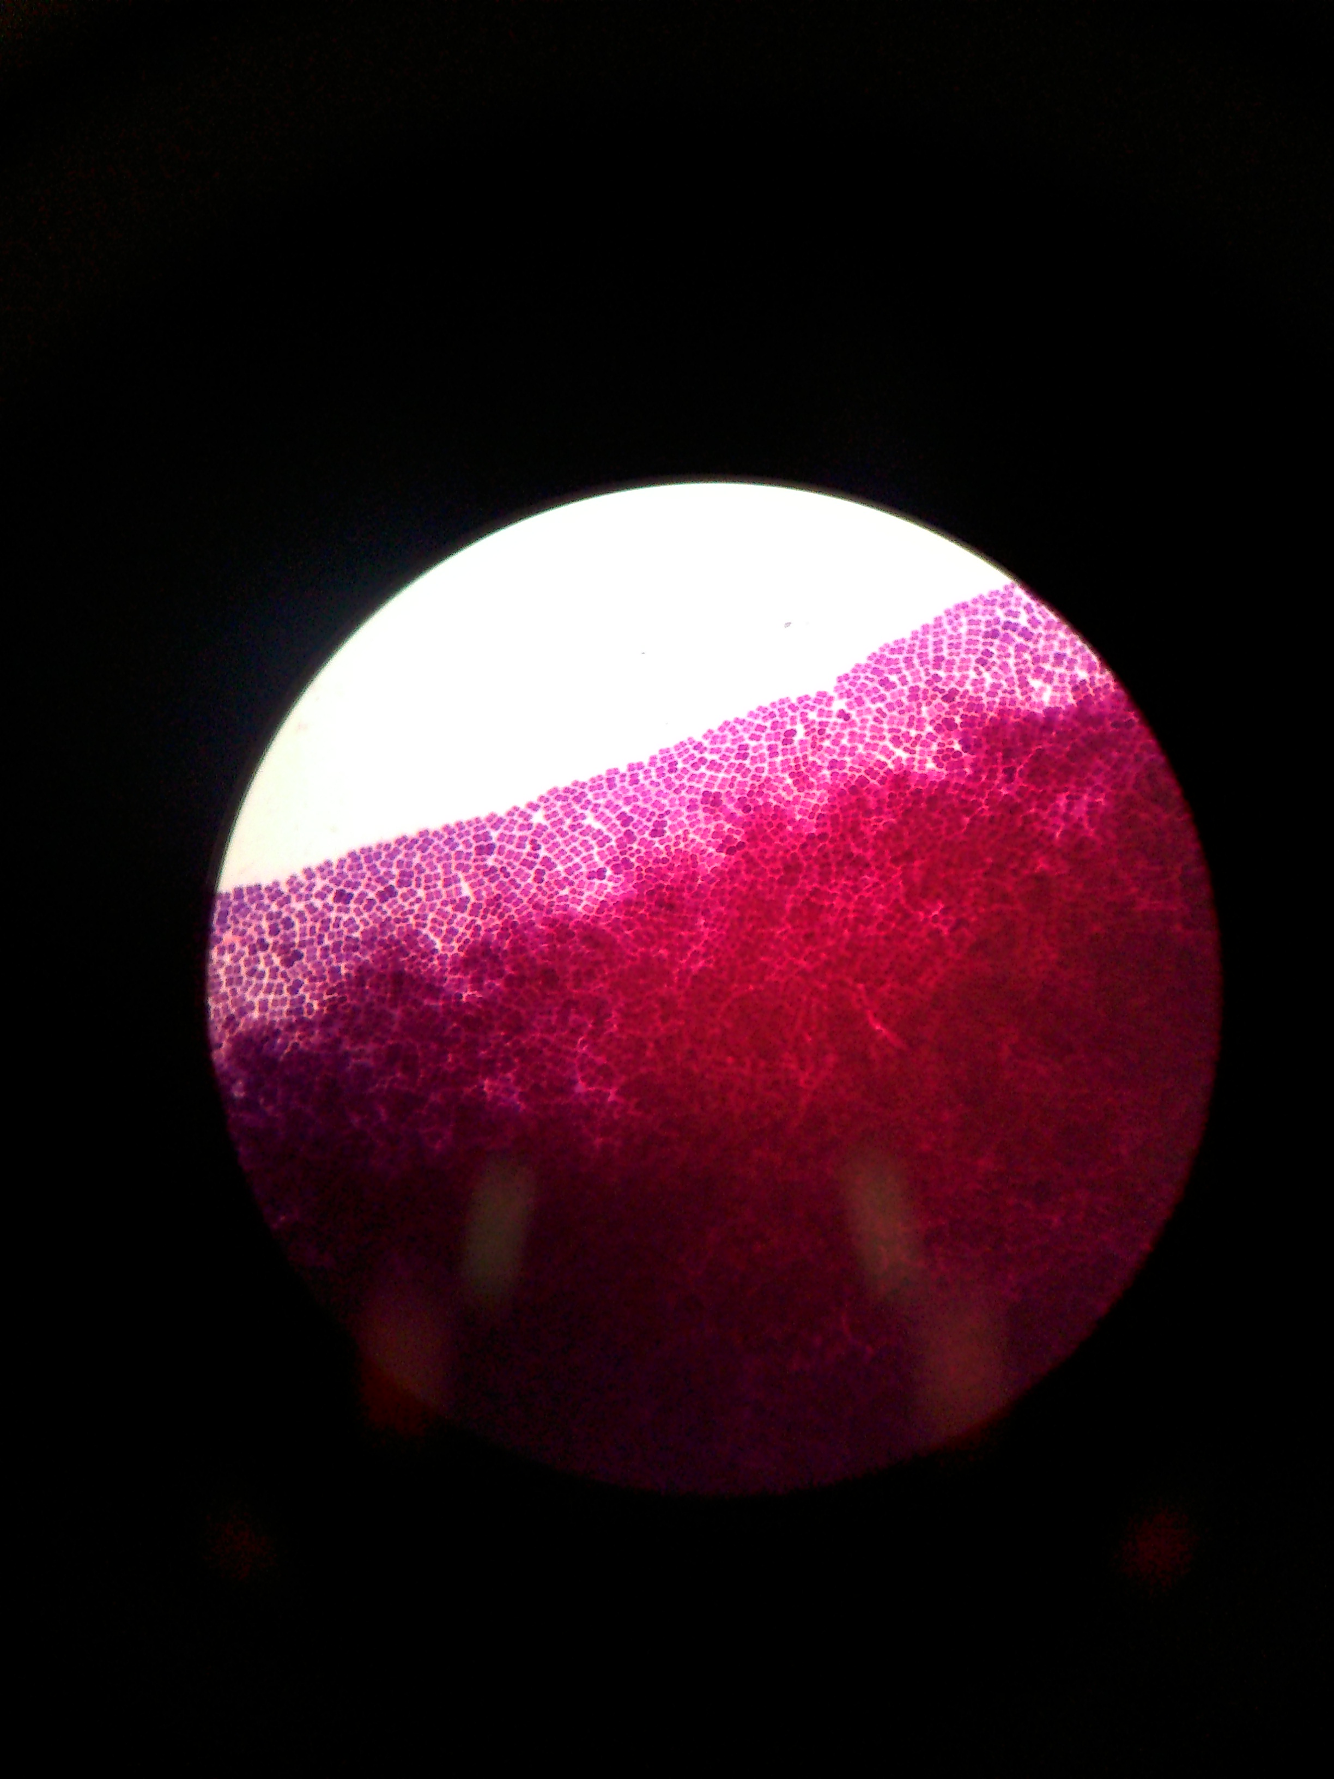
Biology
Deinococcus radiodurans: extremophilic , gram positive bacteria.
Ideal candidate for this experiment because of its extremophile properties.
Near space flight expected to have a negative effect on bacterial growth, but not expected to kill the bacteria.

Slide 15
Eins ist Keins
Two completely separate electronic sub-systems
Processers, circuit boards, power supplies, sensors
Redundancy nearly doubles your chances of success.
Redundancy gives you two chances to fail.

Slide 16
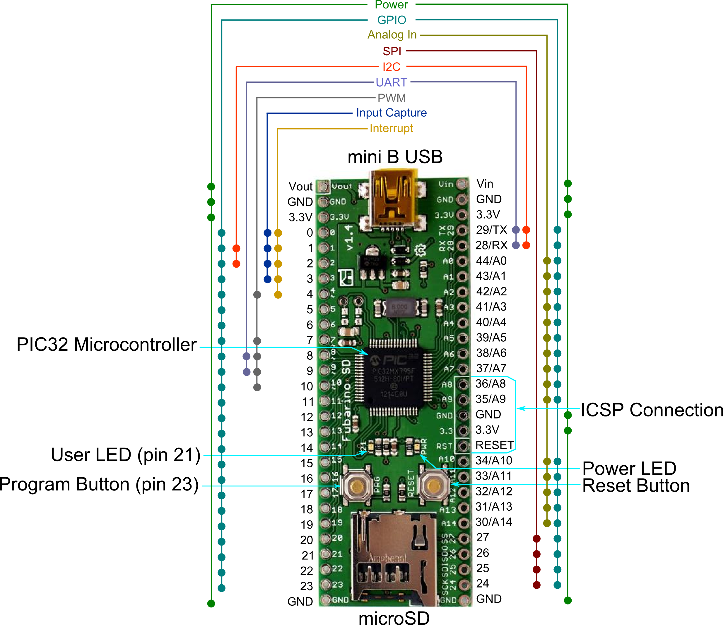
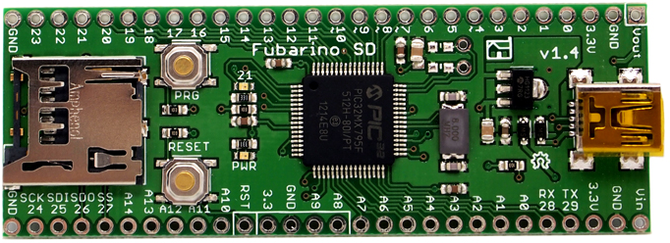
The microprocessor
ChipKIT Fubarino SD
And no, we didn’t use an Arduino
Arduino Compatible
PIC32MX795F512H with 512K Flash, 128K RAM @ 80MHz
45 Digital IO (many are 5V tolerant)
15 Analog inputs (10-bit), and 2 UARTs
MicroSD slot connected to the PIC32 SPI port
Can be powered via USB, or 2.3V to 13V DC input power

Slide 17
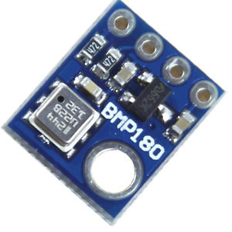
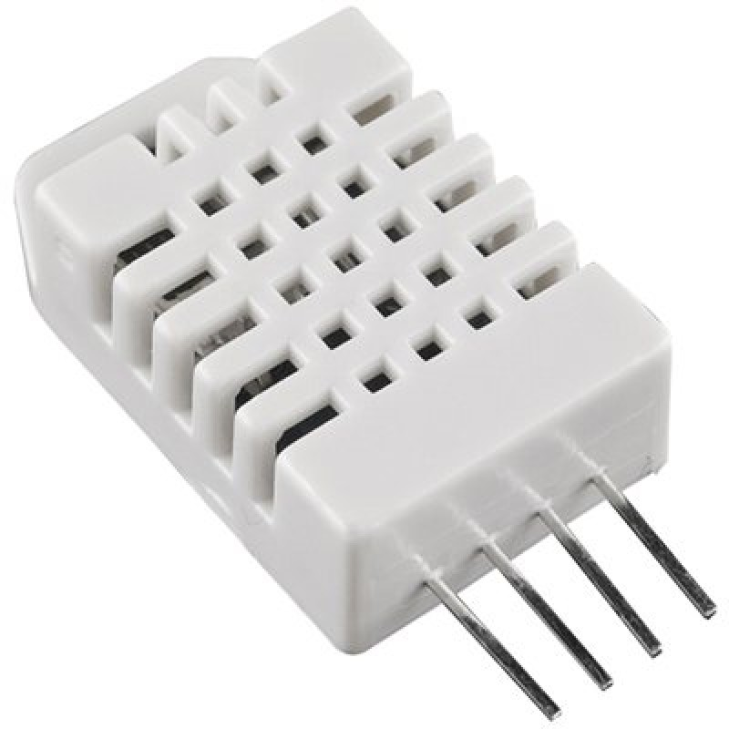
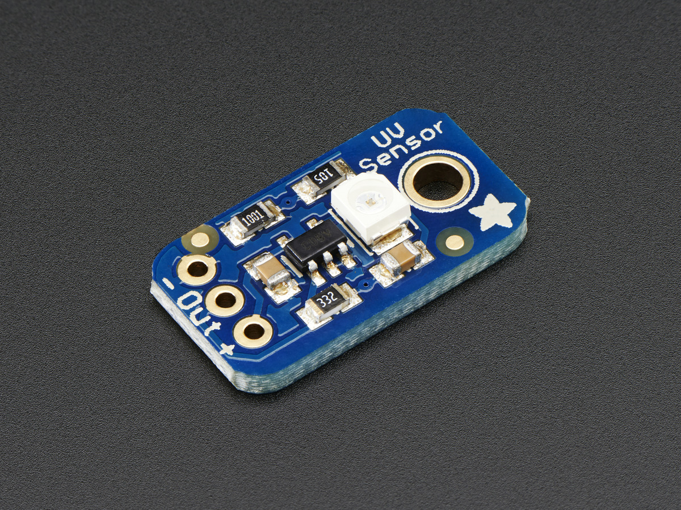
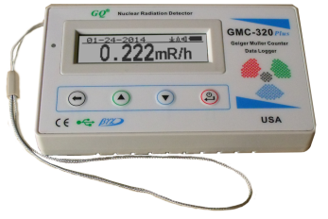
Sensors
BMP180
DHT22
UV Light Sensor
GMC-320 plus Geiger Counter

Slide 18



Acknowledgements
Danielle Brokaw
Dr. James Tuohy
Rhonda Lee
Arizona Space Grant Consortium
NASA
Arizona Near Space Research

